Slide 1
CS1231
Tutorial 2

Slide 2
Things to do
Things to note
About the quiz
Review of lectures
Sheet 2
Revision
Questions
Conclusion

Slide 3
Things to note
We will go through sheet 2 today.
As usual, I encourage participation at appropriate times.
Participation includes unmuting, introducing yourself and using the annotate button on zoom.
If you do not wish to participate or , click the cross reaction. If I do not see a cross then I will assume that I can call upon you.
If you want to be want to ensure that you’re called upon then click on the tick reaction.
If you have a question raise your hand. Please save longer and more involved questions for the end of the class. Alternatively you can email me.

Slide 4
Things to note
You are free to change your reaction as the lesson progresses.
We will not go through * questions. They will be saved for Professor Tay’s tutorial.

Slide 5
About the quiz
The sample quiz has questions of a similar style to the tutorial sheets.
This should hold true for most courses at university.
When revising for the quiz, please review your notes (definitions, proofs and examples) as well as you tutorial sheets.
Make sure you know how to do every question on your sheets and that you understand what is going on.
Organize your notes in advance so you know where to find the information you need during the quiz.

Slide 6
Review of lectures (Participation)
Let P(x) be a predicate and D be the domain of x.
What does it mean for P(x) to be a universal statement?
What does it mean for P(x) to be an existential statement?

Slide 7
Review of lectures (Participation)
Q(x) is a universal statement defined to be true iff Q(x) is true for every value of x in D and false iff Q(x) is false for one or more values of x in D.
Q(x) is an existential statement defined to be true iff Q(x) is true for one or more values of x in D and false iff Q(x) is false for every value of x in D

Slide 8
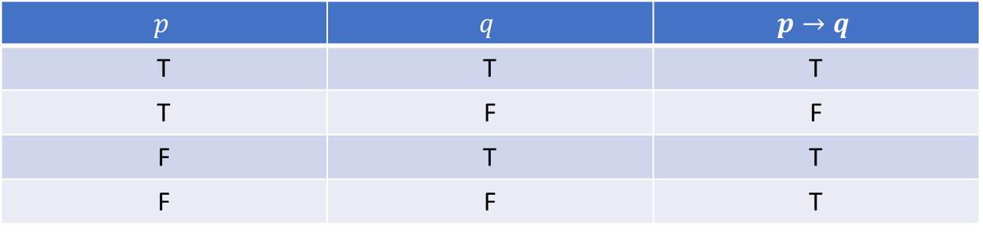
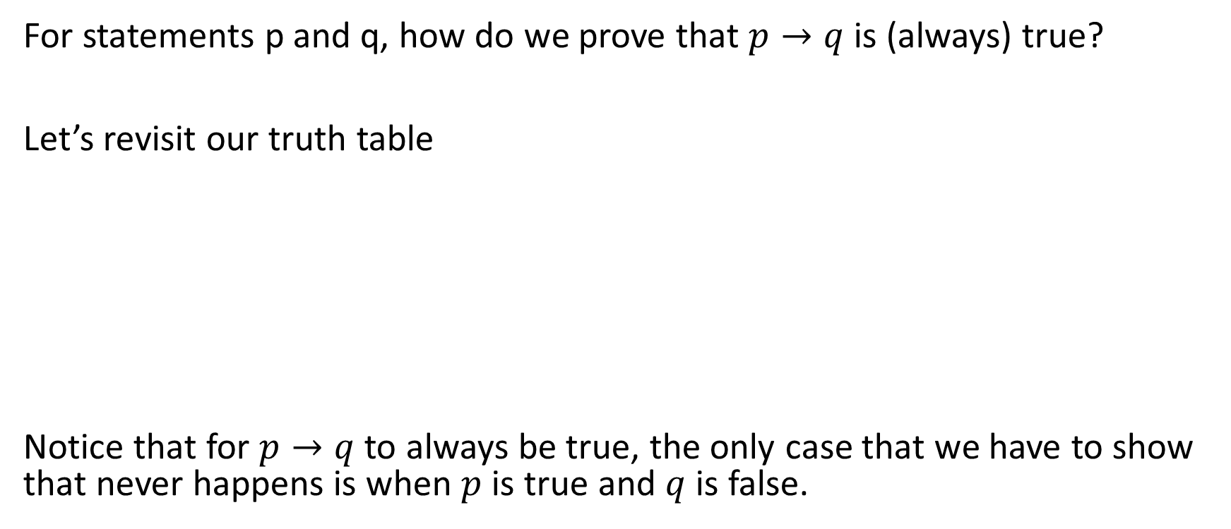
Review of lectures
For statements p and q, how do we prove that $p→q$ is (always) true?
Let’s revisit our truth table
Notice that for $p→q$ to always be true, the only case that we have to show that never happens is when $p$ is true and $q$ is false.
$$p$$ | $$q$$ | $$p→q$$
T | T | T
T | F | F
F | T | T
F | F | T

Slide 9
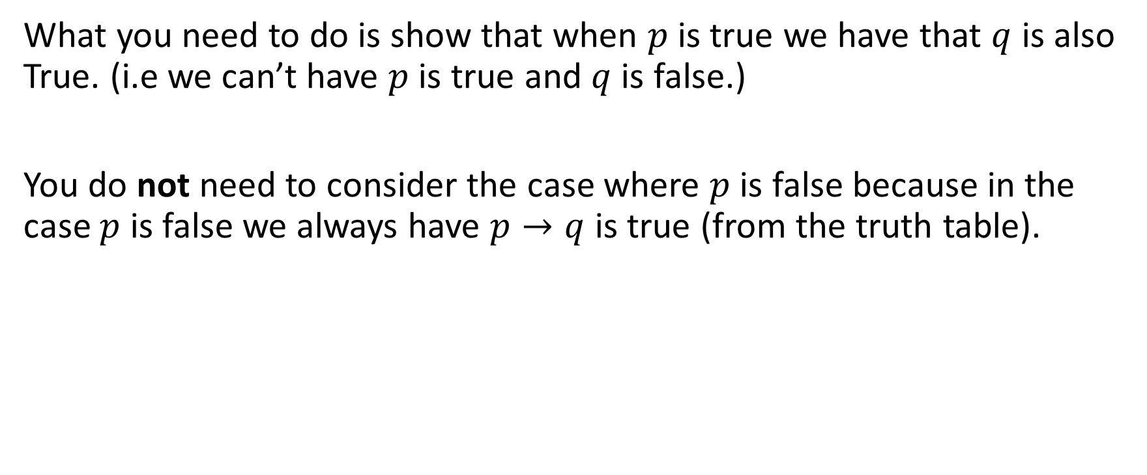
Review of lectures
What you need to do is show that when $p$ is true we have that $q$ is also True. (i.e we can’t have $p$ is true and $q$ is false.)
You do not need to consider the case where $p$ is false because in the case $p$ is false we always have $p→q$ is true (from the truth table).

Slide 10
Sheet 2: Question 1
This question is prompting you to think about how the universal and existential quantifiers interact with conjunctions, disjunctions and negations.

Slide 11
Sheet 2: Question 1 (Participation)
Let P and Q be predicates. Prove that
i. (∀x ∈ D P(x)) ∧ (∀x ∈ D Q(x)) is true if and only if ∀x ∈ D (P(x) ∧ Q(x)) is true.

Slide 12
Sheet 2: Question 1 (Participation)
Let P and Q be predicates. Prove that (∀x ∈ D P(x)) ∧ (∀x ∈ D Q(x)) is true if and only if ∀x ∈ D (P(x) ∧ Q(x)) is true.
Ans: (⇒) Suppose (∀x ∈ D P(x)) ∧ (∀x ∈ D Q(x)) is true. Consider any a ∈ D. P(a) is true; similarly, Q(a) is true. Therefore P(a) ∧ Q(a) is true for any a ∈ D, i.e. ∀x ∈ D (P(x) ∧ Q(x)) is true.
(⇐) Suppose ∀x ∈ D (P(x)∧Q(x)) is true. Consider any a ∈ D. Then P(a)∧Q(a) is true, so P(a) is true and Q(a) is true. Since P(a) is true for any a ∈ D, we have ∀x ∈ D P(x) is true; similarly, ∀x ∈ D Q(x) is true. Therefore, (∀x ∈ D P(x))∧(∀x ∈ D Q(x)) is true.

Slide 13
Sheet 2: Question 1 (Participation)
1.ii Let P and Q be predicates. Prove that (∃x ∈ D P(x)) ∧ (∃x ∈ D Q(x)) and ∃x ∈ D (P(x) ∧ Q(x)) are not equivalent.

Slide 14
Sheet 2: Question 1 (Participation)
Let P and Q be predicates. Prove that (∃x ∈ D P(x)) ∧ (∃x ∈ D Q(x)) and ∃x ∈ D (P(x) ∧ Q(x)) are not equivalent.
Ans: Let D={3,4},
P(x) be the statement that x is prime
Q(x) be the statement that x is even.
(∃x ∈ D P(x)) ∧ (∃x ∈ D Q(x)) is true.
∃x ∈ D (P(x) ∧ Q(x)) is false.

Slide 15
Rules of universal and existential quantifiers
This part of the tutorial is non-examinable and is for enrichment purposes.
It is however useful to know.
You can find the information in Set theory: A first course by Daniel W. Cunningham chp 1.3 (pg 18-19).
Here is the link for reference:
https://books.google.com.sg/books/about/Set_Theory.html?id=S1GJDAAAQBAJ&printsec=frontcover&source=kp_read_button&hl=en&redir_esc=y#v=onepage&q&f=false

Slide 16
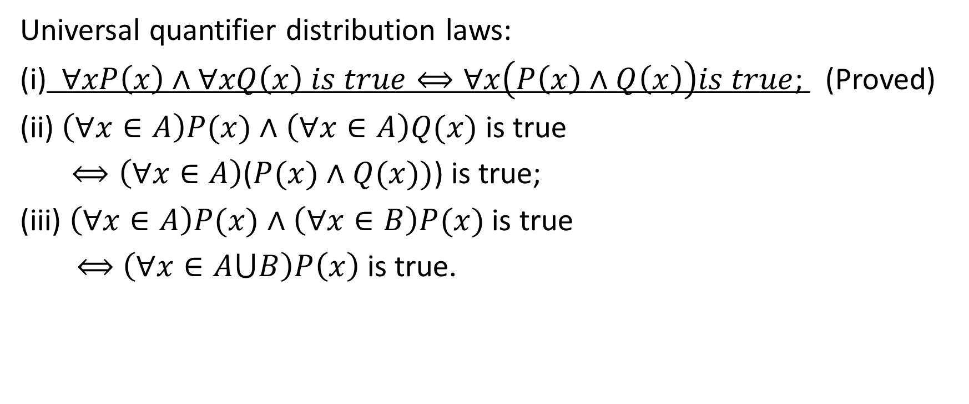
Rules of universal and existential quantifiers
Universal quantifier distribution laws:
(i)$∀xP\left(x\right)∧∀xQ\left(x\right) is true⟺∀x\left(P\left(x\right)∧Q\left(x\right)\right)is true$; (Proved)
(ii) $\left(∀x∈A\right)P(x)∧$ $\left(∀x∈A\right)Q(x)$ is true
$⟺\left(∀x∈A\right)$($P(x)∧Q(x))$) is true;
(iii) $\left(∀x∈A\right)P(x)∧$ $\left(∀x∈B\right)P(x)$ is true
$⟺$ $\left(∀x∈A⋃B\right)P\left(x\right)$ is true.

Slide 17

Rules of universal and existential quantifiers (Participation)
Prove (iii) $\left(∀x∈A\right)P(x)∧$ $\left(∀x∈B\right)P(x)$ is true
$⟺$ $\left(∀x∈A⋃B\right)P\left(x\right)$ is true.

Slide 18
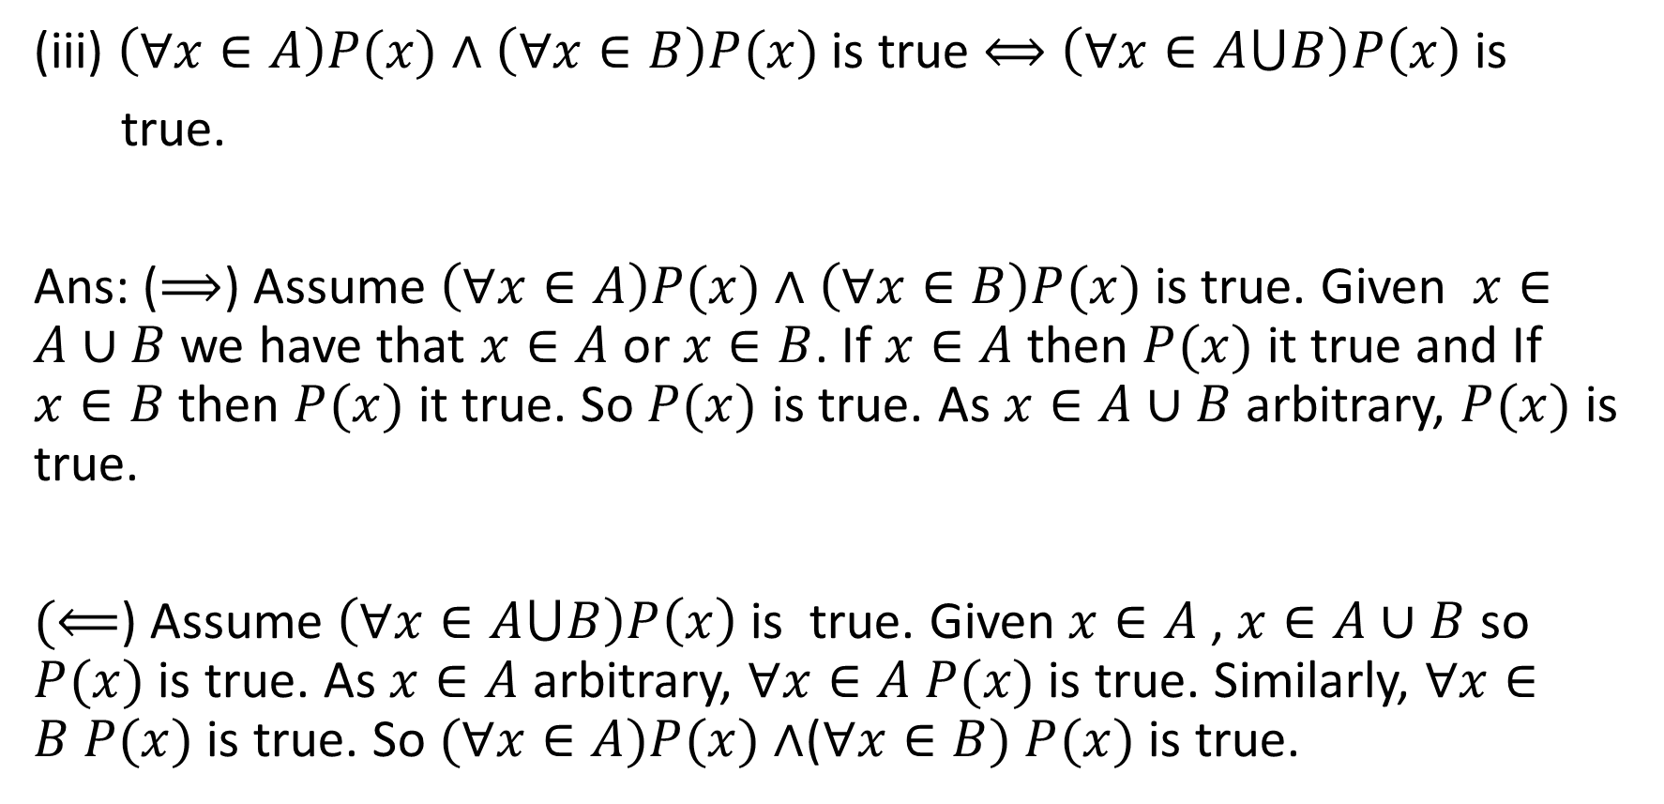
Rules of universal and existential quantifiers (Participation)
(iii) $\left(∀x∈A\right)P(x)∧$ $\left(∀x∈B\right)P(x)$ is true $⟺$ $\left(∀x∈A⋃B\right)P\left(x\right)$is
true.
Ans: ($⟹$) Assume $\left(∀x∈A\right)P(x)∧$ $\left(∀x∈B\right)P(x)$ is true. Given $x∈A∪B$ we have that $x∈A$ or $x∈B$. If $x∈A$ then $P(x)$ it true and If $x∈B$ then $P(x)$ it true. So $P(x)$ is true. As $x∈A∪B$ arbitrary, $P(x)$ is true.
$(⟸$) Assume $\left(∀x∈A⋃B\right)P\left(x\right)$is true. Given $x∈A$ , $x∈A∪B$ so $P(x)$ is true. As $x∈A$ arbitrary, $∀x∈A P(x)$ is true. Similarly, $∀x∈B P(x)$ is true. So $(∀x∈A)P(x)∧$($∀x∈B) P(x)$ is true.

Slide 19
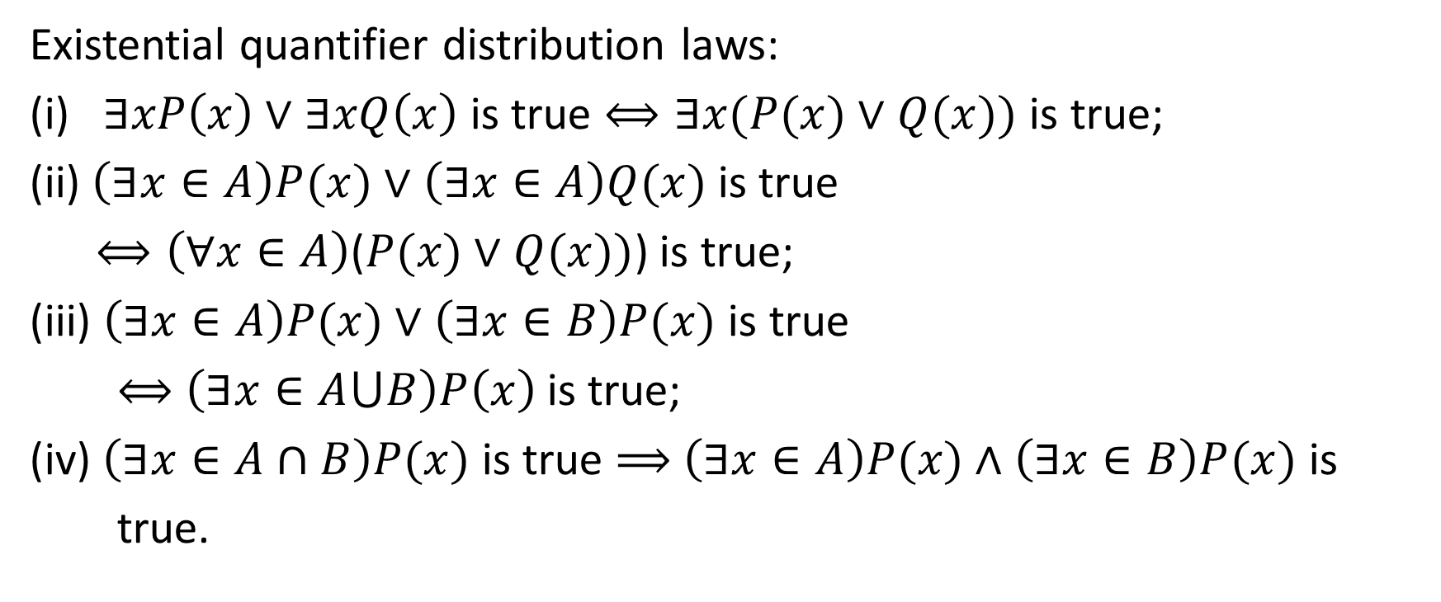
Rules of universal and existential quantifiers
Existential quantifier distribution laws:
(i) $∃xP\left(x\right)∨∃xQ\left(x\right)$ is true $⟺∃x(P(x)∨Q(x))$ is true;
(ii) $\left(∃x∈A\right)P(x)∨$ $\left(∃x∈A\right)Q(x)$ is true
$⟺\left(∀x∈A\right)$($P(x)∨Q(x))$) is true;
(iii) $\left(∃x∈A\right)P(x)∨$ $\left(∃x∈B\right)P(x)$ is true
$⟺$ $\left(∃x∈A⋃B\right)P\left(x\right)$ is true;
(iv) $\left(∃x∈A∩B\right)P(x)$ is true $⟹$ $\left(∃x∈A\right)P(x)∧$ $\left(∃x∈B\right)P(x)$ is
true.

Slide 20

Rules of universal and existential quantifiers (Participation)
Prove (iv) $\left(∃x∈A∩B\right)P(x)$ is true $⟹$
$\left(∃x∈A\right)P(x)∧$ $\left(∃x∈B\right)P(x)$ is true.
Does the converse hold?

Slide 21
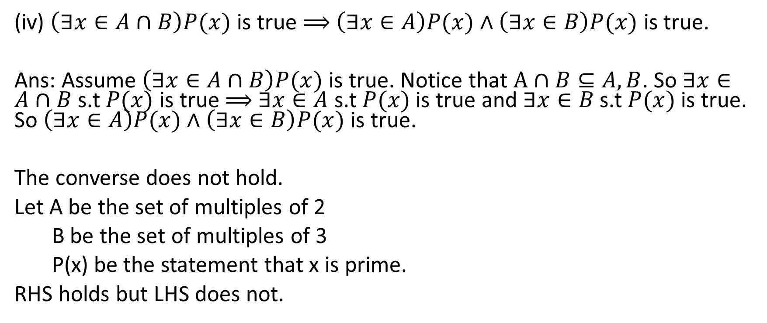
Rules of universal and existential quantifiers (Participation)
(iv) $\left(∃x∈A∩B\right)P(x)$ is true $⟹$ $\left(∃x∈A\right)P(x)∧$ $\left(∃x∈B\right)P(x)$ is true.
Ans: Assume $\left(∃x∈A∩B\right)P(x)$ is true. Notice that $A∩B⊆A,B$. So $∃x∈A∩B$ s.t $P(x)$ is true $⟹$ $∃x∈A$ s.t $P(x)$ is true and $∃x∈B$ s.t $P(x)$ is true. So $\left(∃x∈A\right)P(x)∧$ $\left(∃x∈B\right)P(x)$ is true.
The converse does not hold.
Let A be the set of multiples of 2
B be the set of multiples of 3
P(x) be the statement that x is prime.
RHS holds but LHS does not.

Slide 22
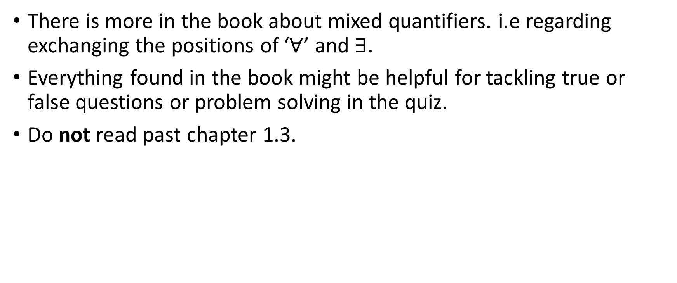
Rules of universal and existential quantifiers
There is more in the book about mixed quantifiers. i.e regarding exchanging the positions of ‘$∀$’ and $∃$.
Everything found in the book might be helpful for tackling true or false questions or problem solving in the quiz.
Do not read past chapter 1.3.

Slide 23
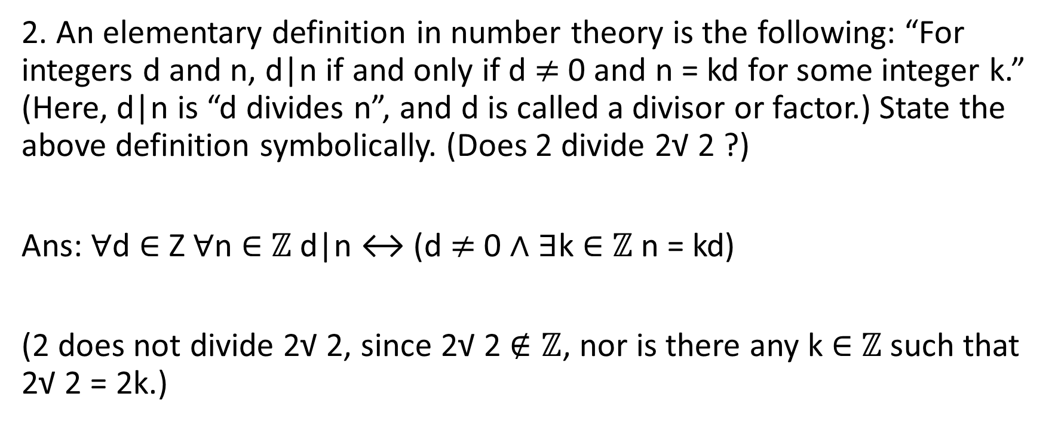
Sheet 2: Question 2
2. An elementary definition in number theory is the following: “For integers d and n, d|n if and only if d $≠$ 0 and n = kd for some integer k.” (Here, d|n is “d divides n”, and d is called a divisor or factor.) State the above definition symbolically. (Does 2 divide 2√ 2 ?)
Ans: ∀d ∈ Z ∀n ∈ $ℤ$ d|n ↔ (d $≠$ 0 ∧ ∃k ∈ $ℤ$ n = kd)
(2 does not divide 2√ 2, since 2√ 2 $∉ℤ$, nor is there any k ∈ $ℤ$ such that 2√ 2 = 2k.)

Slide 24
Sheet 2: Question 3
Starred question. We defer to the professor’s tutorial.

Slide 25
Sheet 2: Question 4 (Participation)
4. We will soon introduce the concept of a “relation”. For a binary relation R on a set A, there are three important properties:
R is said to be reflexive if and only if “xRx for any x in A”.
R is symmetric if and only if “for every x and y in A, if xRy then yRx.”
R is transitive if and only if “for all x, y and z in A, if xRy and yRz, then xRz.”
For each property, state the condition (“...”) symbolically.

Slide 26
Sheet 2: Question 4 (Participation)
a. R is said to be reflexive if and only if “xRx for any x in A”.
b. R is symmetric if and only if “for every x and y in A, if xRy then yRx.”
c. R is transitive if and only if “for all x, y and z in A, if xRy and yRz, then xRz.”

Slide 27
Sheet 2: Question 4
Ans:
Reflexive: ∀x ∈ A xRx
Symmetric: ∀x ∈ A ∀y ∈ A xRy → yRx
Transitive: ∀x ∈ A ∀y ∈ A ∀z ∈ Z xRy ∧ yRz → xRz

Slide 28
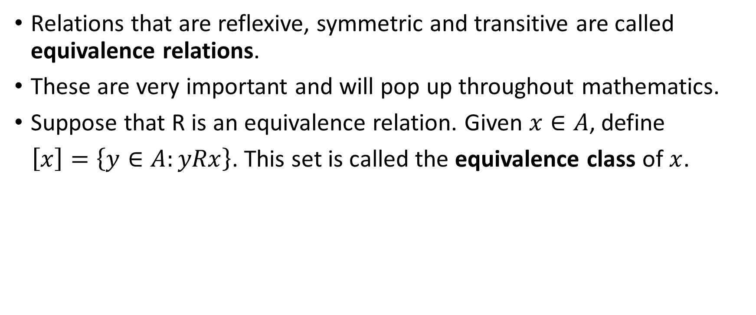
Sheet 2: Question 4
Relations that are reflexive, symmetric and transitive are called equivalence relations.
These are very important and will pop up throughout mathematics.
Suppose that R is an equivalence relation. Given $x∈A$, define
$\left[x\right]=\left\{y∈A:yRx\right\}$. This set is called the equivalence class of $x$.

Slide 29
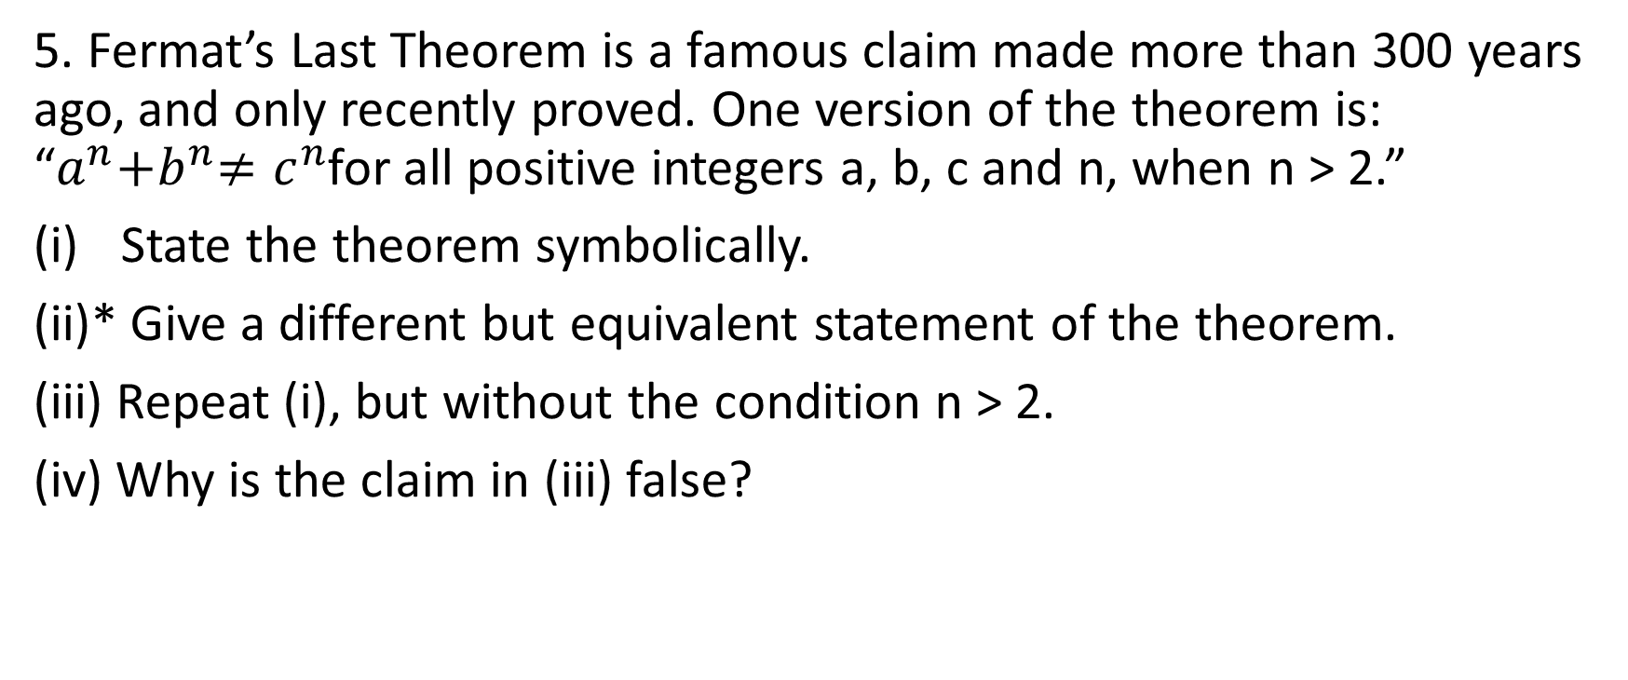
Sheet 2: Question 5
5. Fermat’s Last Theorem is a famous claim made more than 300 years ago, and only recently proved. One version of the theorem is: “$a^{n}{+b}^{n}≠c^{n}$for all positive integers a, b, c and n, when n > 2.”
State the theorem symbolically.
(ii)* Give a different but equivalent statement of the theorem.
(iii) Repeat (i), but without the condition n > 2.
(iv) Why is the claim in (iii) false?

Slide 30
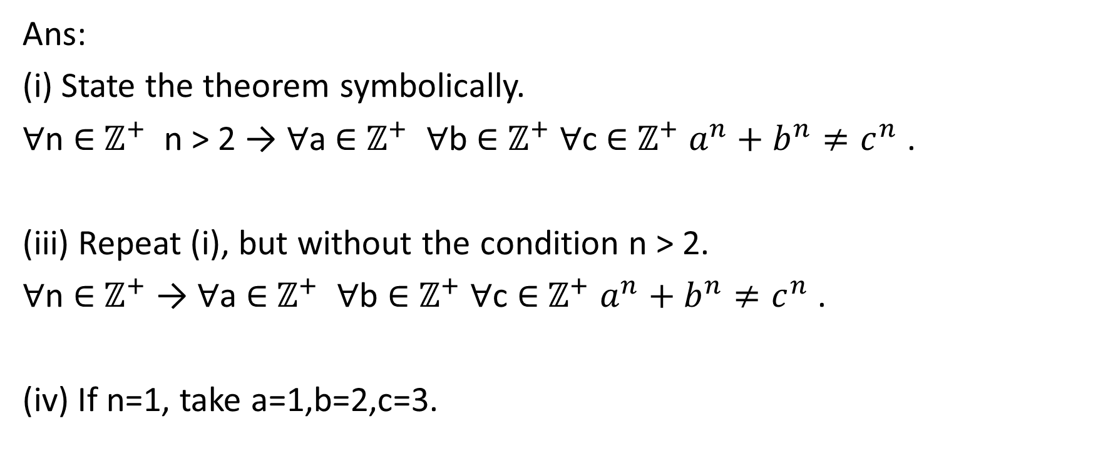
Sheet 2: Question 5
Ans:
(i) State the theorem symbolically.
∀n ∈ $ℤ^{+}$ n > 2 → ∀a ∈ $ℤ^{+}$ ∀b ∈ $ℤ^{+}$ ∀c ∈ $ℤ^{+}$ $a^{n}+b^{n}{≠c}^{n}$ .
(iii) Repeat (i), but without the condition n > 2.
∀n ∈ $ℤ^{+}$ → ∀a ∈ $ℤ^{+}$ ∀b ∈ $ℤ^{+}$ ∀c ∈ $ℤ^{+}$ $a^{n}+b^{n}{≠c}^{n}$ .
(iv) If n=1, take a=1,b=2,c=3.

Slide 31
Sheet 2: Question 5
Fermat’s last theorem was first posed by Fermat in 1637 in the Arithmetica. In which he stated that he had the proof to this theorem but that it was too large to fit in the margins of this text.
It was proved more than 300 years later by Andrew Wiles in 1995.
He spent 7 years in isolation to work on the proof that would win him the Abel prize.
Working up to his proof of this result, Wiles proved the even more general modularity theorem.

Slide 32
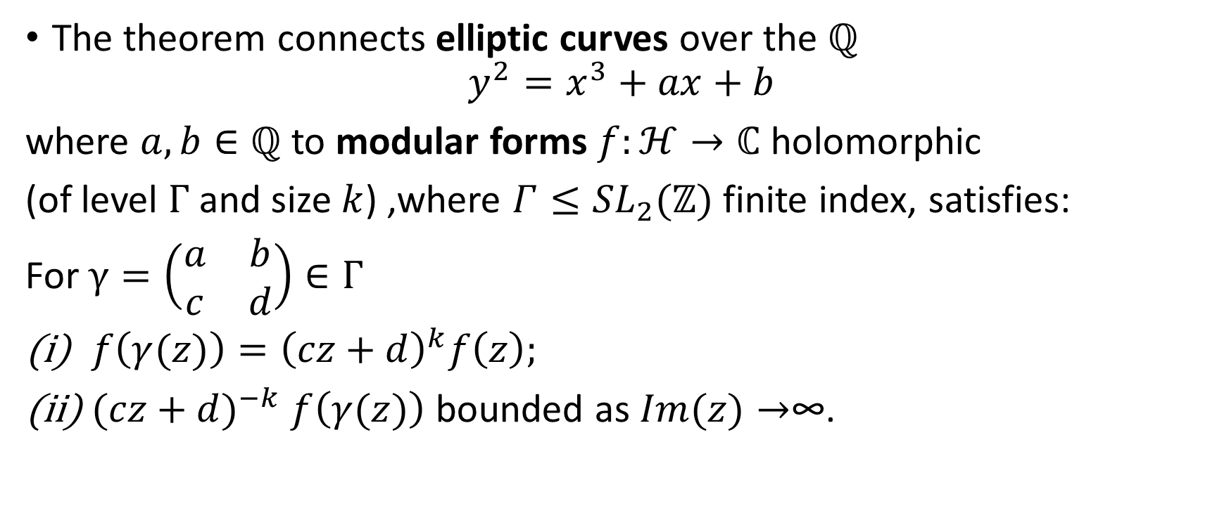
Sheet 2: Question 5
The theorem connects elliptic curves over the $ℚ$
$$y^{2}=x^{3}+ax+b$$
where $a,b∈ℚ$ to modular forms $f:ℋ→ℂ$ holomorphic
(of level $Γ$ and size $k$) ,where $Γ≤{SL}_{2}(ℤ)$ finite index, satisfies:
For $γ=\left(\begin{matrix}a & b \\ c & d\end{matrix}\right)∈Γ$
$f\left(γ(z)\right)={\left(cz+d\right)}^{k}f\left(z\right);$
${(cz+d)}^{−k}$ $f\left(γ(z)\right)$ bounded as $Im(z)→$∞.

Slide 33
Sheet 2: Question 5
A discussion about lifting (time permitting).

Slide 34
Sheet 2: Question 6
6. Another famous claim is the Goldbach Conjecture (about 200 years old, still unproven):
“Every even integer greater than 2 can be represented as the sum of two prime numbers.”
(i) State the conjecture symbolically.
(ii) How can you show that the conjecture is wrong (and therefore become instantly
famous)?
(Definitions: An integer n is even if and only if there is an integer k such that n = 2k; an
integer n is odd if and only if there is an integer k such that n = 2k + 1. We can introduce
predicates Even and Odd and write these symbolically as Even(n) ↔ ∃k ∈ Z n = 2k and
Odd(n) ↔ ∃k ∈ Z n = 2k + 1.

Slide 35
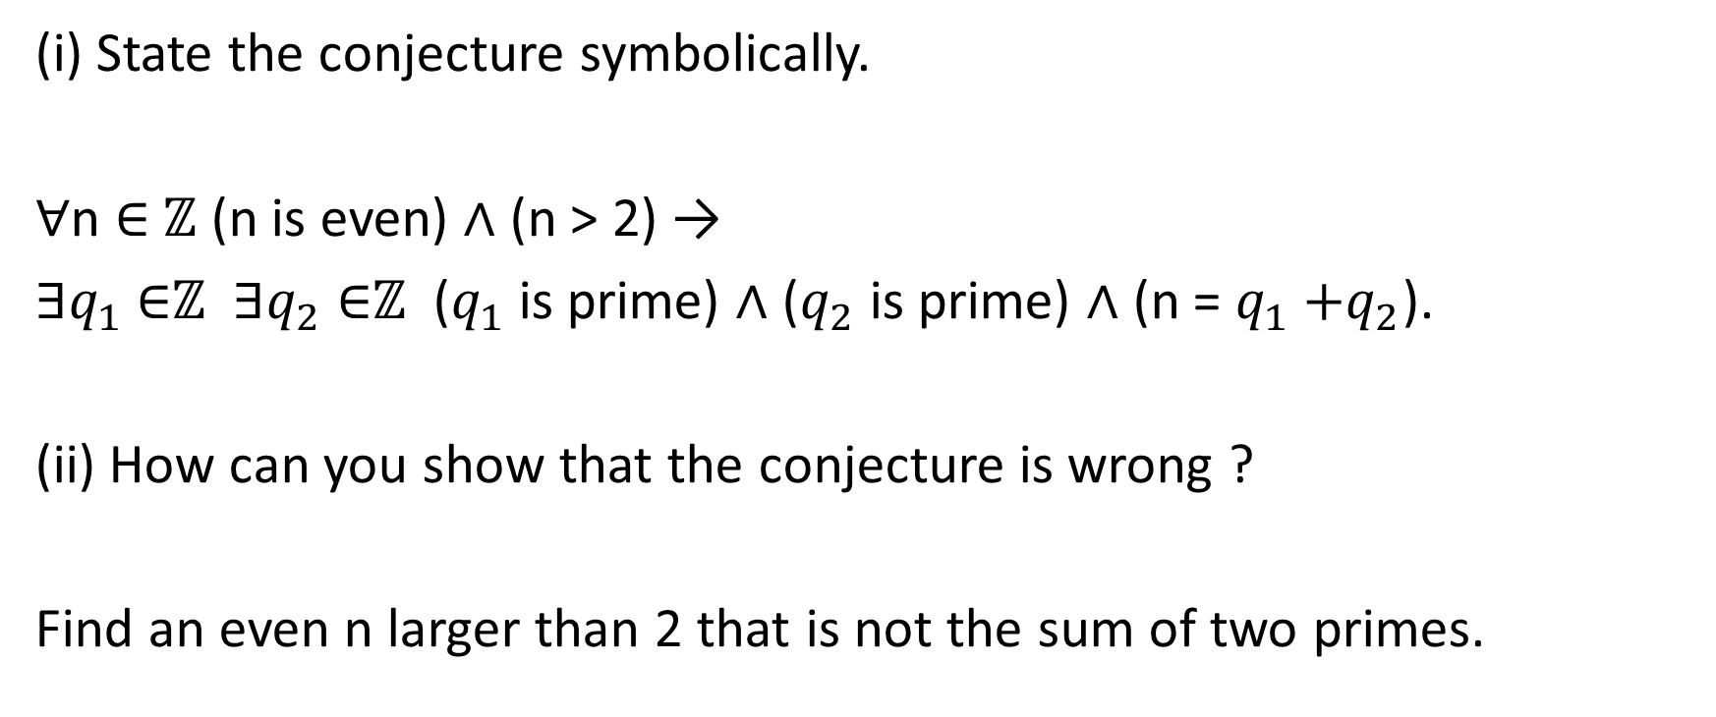
Sheet 2: Question 6
(i) State the conjecture symbolically.
∀n ∈ $ℤ$ (n is even) ∧ (n > 2) →
∃$q_{1}$ ∈$ℤ$ ∃$q_{2}$ ∈$ℤ$ ($q_{1}$ is prime) ∧ ($q_{2}$ is prime) ∧ (n = $q_{1}{+q}_{2}$).
(ii) How can you show that the conjecture is wrong ?
Find an even n larger than 2 that is not the sum of two primes.

Slide 36
Sheet 2: Question 7
Starred question. We defer to the professor’s tutorial.

Slide 37
Sheet 2: Question 8,9,10,11,12,13
The main point of the last set of questions is to highlight how badly proofs can go wrong when you are not using correct arguments and logic. Be alert!
In practice however, we merely carry out correct proof arguments. We usually don’t state what kind of argument we are using unless it is unclear.

Slide 38
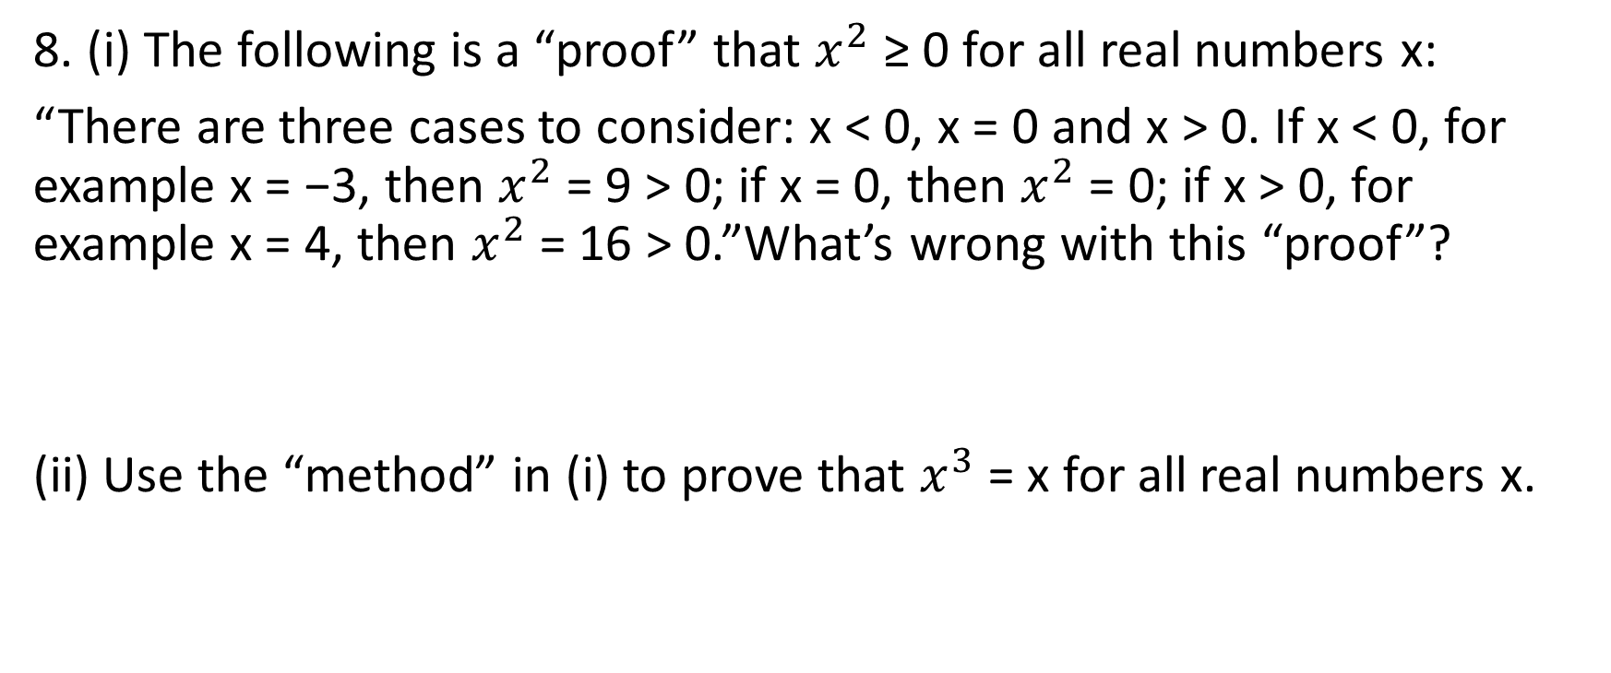
Sheet 2: Question 8 (Participation)
8. (i) The following is a “proof” that $x^{2}$ ≥ 0 for all real numbers x:
“There are three cases to consider: x < 0, x = 0 and x > 0. If x < 0, for example x = −3, then $x^{2}$= 9 > 0; if x = 0, then $x^{2}$= 0; if x > 0, for example x = 4, then $x^{2}$ = 16 > 0.”What’s wrong with this “proof”?
(ii) Use the “method” in (i) to prove that $x^{3}$ = x for all real numbers x.

Slide 39
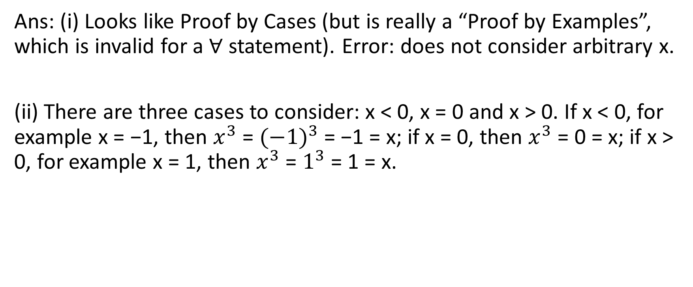
Sheet 2: Question 8 (Participation)
Ans: (i) Looks like Proof by Cases (but is really a “Proof by Examples”, which is invalid for a ∀ statement). Error: does not consider arbitrary x.
(ii) There are three cases to consider: x < 0, x = 0 and x > 0. If x < 0, for example x = −1, then $x^{3}$ = ${(−1)}^{3}$ = −1 = x; if x = 0, then $x^{3}$ = 0 = x; if x > 0, for example x = 1, then $x^{3}$ = $1^{3}$ = 1 = x.

Slide 40
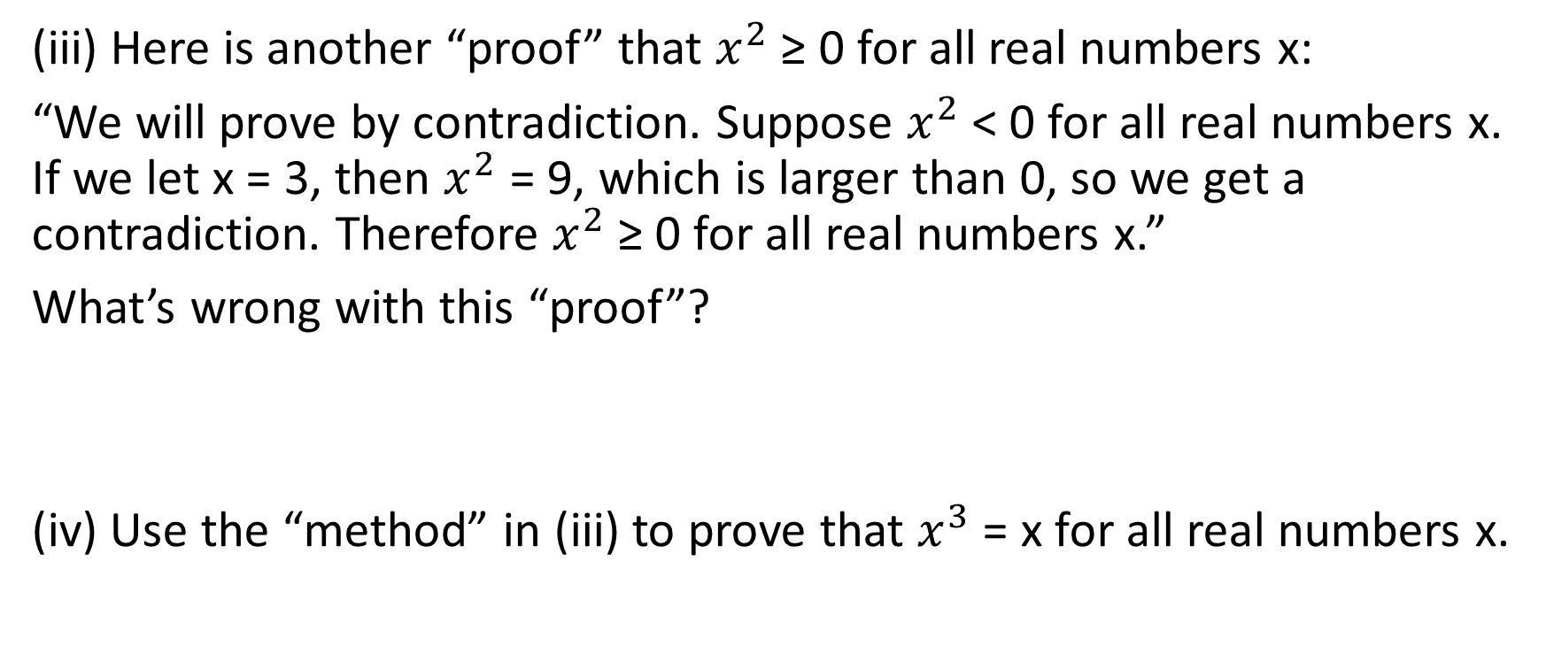
Sheet 2: Question 8 (Participation)
(iii) Here is another “proof” that $x^{2}$ ≥ 0 for all real numbers x:
“We will prove by contradiction. Suppose $x^{2}$ < 0 for all real numbers x. If we let x = 3, then $x^{2}$ = 9, which is larger than 0, so we get a contradiction. Therefore $x^{2}$ ≥ 0 for all real numbers x.”
What’s wrong with this “proof”?
(iv) Use the “method” in (iii) to prove that $x^{3}$ = x for all real numbers x.

Slide 41
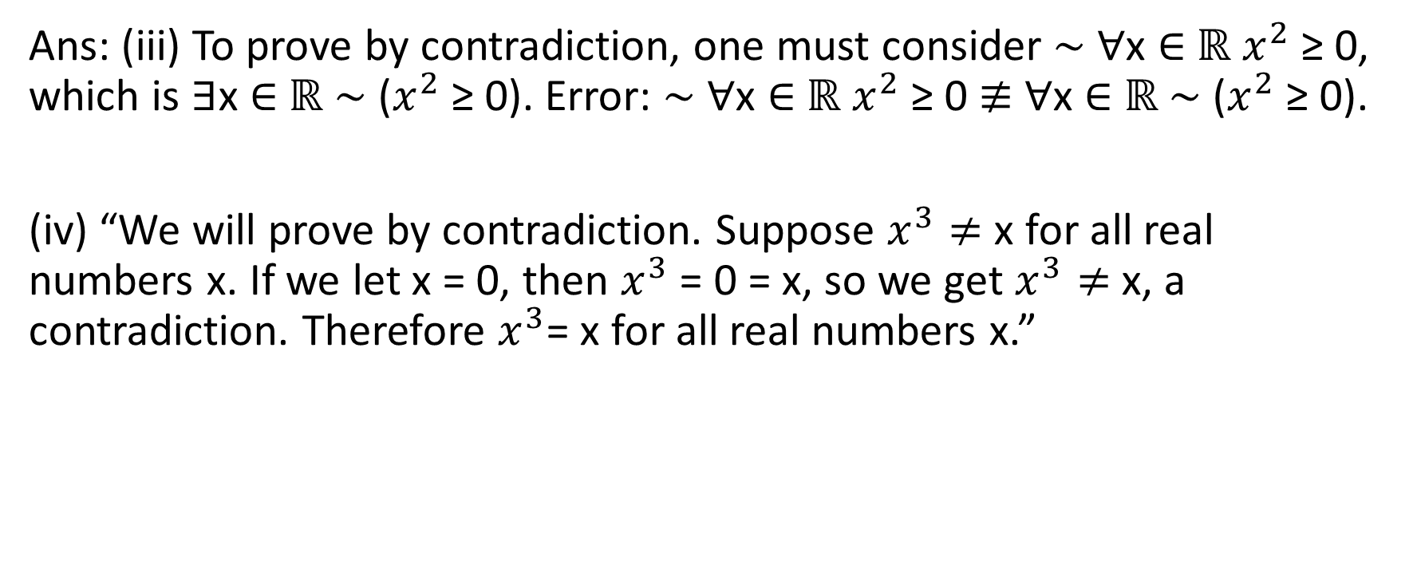
Sheet 2: Question 8 (Participation)
Ans: (iii) To prove by contradiction, one must consider ∼ ∀x ∈ $ℝ$ $x^{2}$ ≥ 0, which is ∃x ∈ $ℝ$ ∼ ($x^{2}$ ≥ 0). Error: ∼ ∀x ∈ $ℝ$ $x^{2}$ ≥ 0 $≢$ ∀x ∈ $ℝ$ ∼ ($x^{2}$ ≥ 0).
(iv) “We will prove by contradiction. Suppose $x^{3}≠$ x for all real numbers x. If we let x = 0, then $x^{3}$ = 0 = x, so we get $x^{3}≠$ x, a contradiction. Therefore $x^{3}$= x for all real numbers x.”

Slide 42
Sheet 2: Questions 9 & 10
Starred questions. We defer to the Professor’s tutorial.

Slide 43
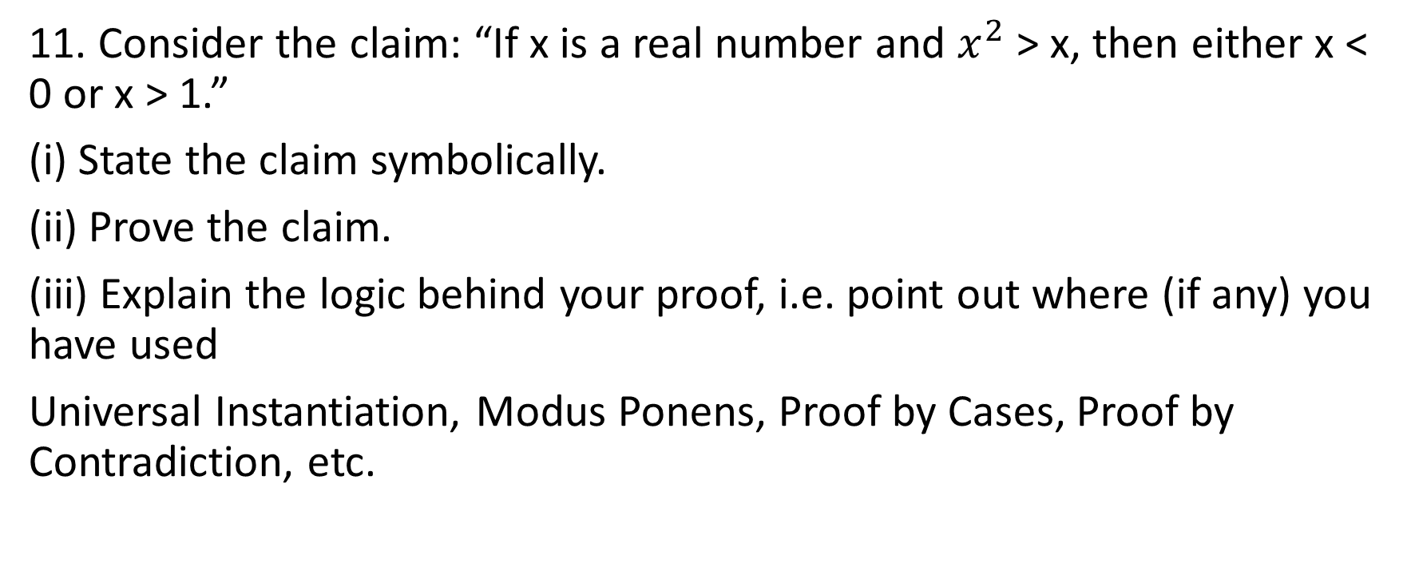
Sheet 2: Question 11
11. Consider the claim: “If x is a real number and $x^{2}$ > x, then either x < 0 or x > 1.”
(i) State the claim symbolically.
(ii) Prove the claim.
(iii) Explain the logic behind your proof, i.e. point out where (if any) you have used
Universal Instantiation, Modus Ponens, Proof by Cases, Proof by Contradiction, etc.

Slide 44
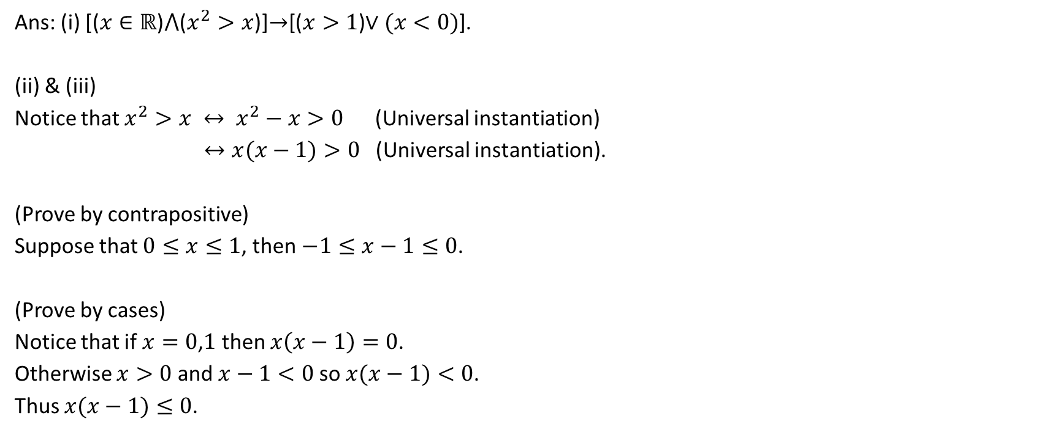
Sheet 2: Question 11
Ans: (i) [($x∈ℝ$)$⋀$($x^{2}>x$)]$→$[($x>1$)$∨(x<0)$].
(ii) & (iii)
Notice that $x^{2}>x ↔ x^{2}−x>0$ (Universal instantiation)
$↔x(x−1)>0$ (Universal instantiation).
(Prove by contrapositive)
Suppose that $0≤x≤1$, then $−1≤x−1≤0$.
(Prove by cases)
Notice that if $x=0$,$1$ then $x\left(x−1\right)=0$.
Otherwise $x>0$ and $x−1<0$so $x(x−1)<0$.
Thus $x(x−1)≤0$.

Slide 45
Sheet 2: Question 12 (Participation)
12. Recall from Problem 6 the definition of odd and even integers. Consider the claim: “There is no integer that is both even and odd.”
(i) State the claim symbolically and prove it.
(ii) Explain the logic behind your proof.
(iii) What’s wrong with this “proof”?
“Suppose there is an integer n that is both even and odd. Since n is even, there is an integer k such that n = 2k. Since n is odd, there is an integer k such that n = 2k+ 1.
Therefore, 2k = 2k + 1; subtracting 2k gives 0 = 1. This is impossible, so n cannot
exist.”

Slide 46
Sheet 2: Question 12 (Participation)
(i) “There is no integer that is both even and odd.”
State the claim symbolically and prove it.
(ii) Explain the logic behind your proof.

Slide 47
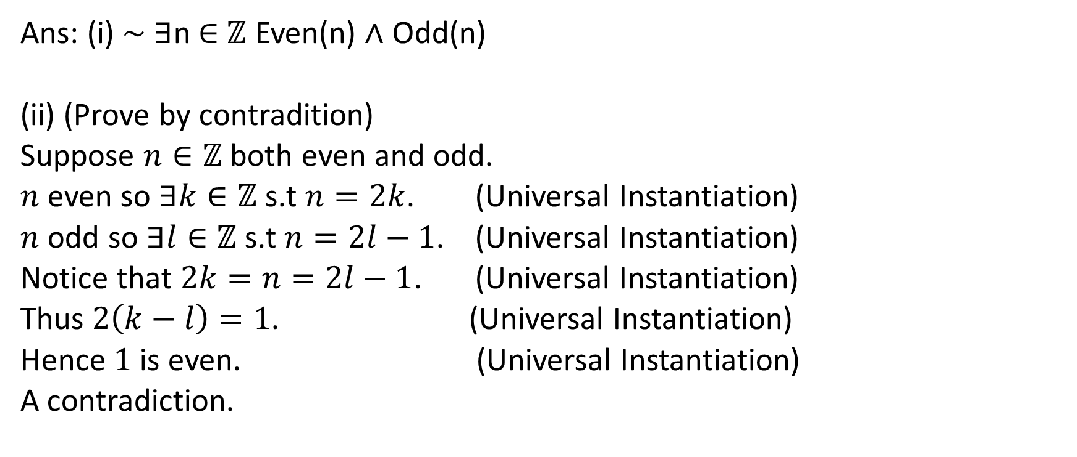
Sheet 2: Question 12 (Participation
Ans: (i) ∼ ∃n ∈ $ℤ$ Even(n) ∧ Odd(n)
(ii) (Prove by contradition)
Suppose $n∈ℤ$ both even and odd.
$n$ even so $∃k∈ℤ$ s.t $n=2k$. (Universal Instantiation)
$n$ odd so $∃l∈ℤ$ s.t $n=2l−1$. (Universal Instantiation)
Notice that $2k=n=2l−1$. (Universal Instantiation)
Thus $2\left(k−l\right)=1$. (Universal Instantiation)
Hence $1$ is even. (Universal Instantiation)
A contradiction.

Slide 48
Sheet 2: Question 12 (Participation)
(iii) “There is no integer that is both even and odd.”
What’s wrong with this “proof”?
“Suppose there is an integer n that is both even and odd. Since n is even, there is an integer k such that n = 2k. Since n is odd, there is an integer k such that n = 2k+ 1.
Therefore, 2k = 2k + 1; subtracting 2k gives 0 = 1. This is impossible, so n cannot exist.”

Slide 49
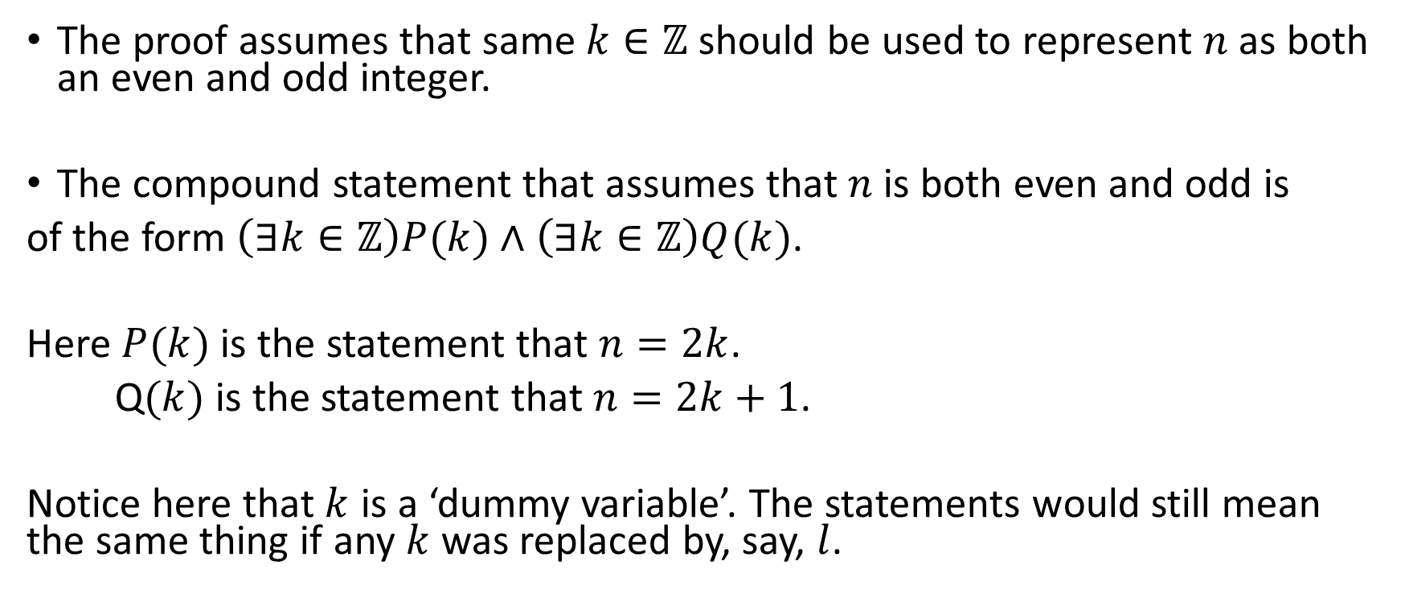
Sheet 2: Question 12
The proof assumes that same $k∈ℤ$ should be used to represent $n$ as both an even and odd integer.
The compound statement that assumes that $n$ is both even and odd is
of the form $\left(∃k∈ℤ\right)P(k)∧$ $\left(∃k∈ℤ\right)Q(k)$.
Here $P(k)$ is the statement that $n=2k$.
Q$(k)$ is the statement that $n=2k+1$.
Notice here that $k$ is a ‘dummy variable’. The statements would still mean the same thing if any $k$ was replaced by, say, $l$.

Slide 50
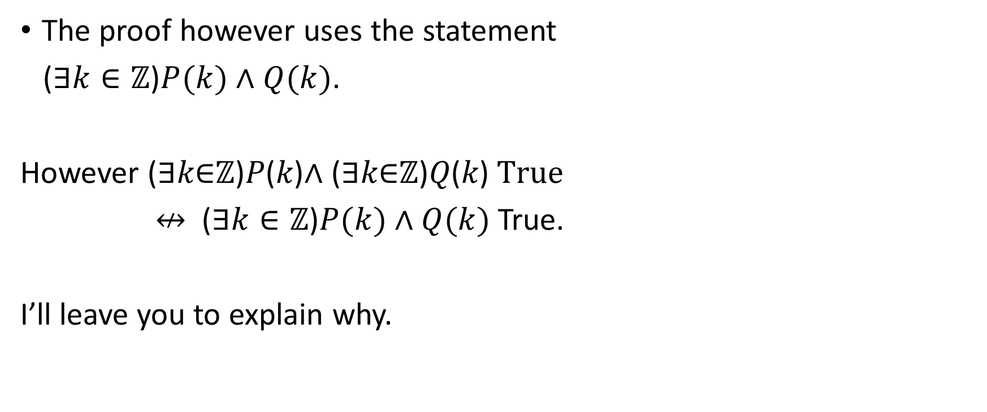
Sheet 2: Question 12
The proof however uses the statement
($∃k∈ℤ$)$P(k)∧Q(k)$.
However (∃𝑘∈ℤ)𝑃(𝑘)∧ (∃𝑘∈ℤ)𝑄(𝑘)$True$
$↮$ ($∃k∈ℤ$)$P(k)∧Q(k)$ True.
I’ll leave you to explain why.

Slide 51
Revision (Participation)
(a) (p ∧ q) → p ≡ T (Specialization)

Slide 52
Revision
(a) (p ∧ q) → p ≡ T (Specialization)
(p ∧ q) → p ≡∼ (p ∧ q) ∨ p (Definition)
≡ ((∼ p) ∨ (∼ q) )∨ p (DeMorgan’s law)
≡ ((∼ p) ∨ p) ∨ (∼ q) (Distribution law)
≡ T ∨ (∼ q) (Negation law)
≡ T. (Identity law)

Slide 53
Revision (Participation)
(e) (∼ p → (q∧ ∼ q)) → p ≡ T (Contradiction)

Slide 54
Revision
(e) (∼ p → (q∧ ∼ q)) → p ≡ T (Contradiction)
(∼ p → (q∧ ∼ q)) → p ≡ (∼ (∼ p → (q∧ ∼ q)))∨p (Definition)
≡ (∼ (p∨(q∧ ∼ q))∨p (Definition)
≡ (∼p∨C)∨p (Negation Law)
≡ (∼ p)∨p (Identity Law)
≡ T. (Negation Law)

Slide 55
Revision (Participation)
State DeMorgan’s Law and prove it using a truth table.

Slide 56
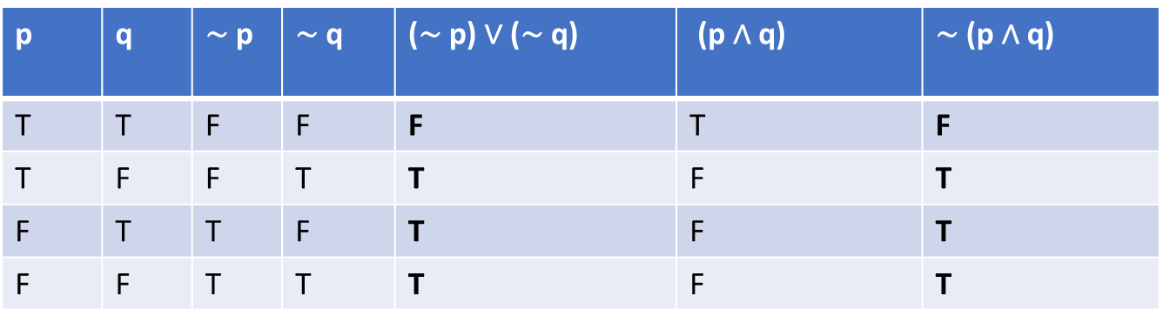
Revision
DeMorgan’s law: ∼ (p ∧ q) ≡ (∼ p) ∨ (∼ q)

Slide 57
Questions

